Slide 1
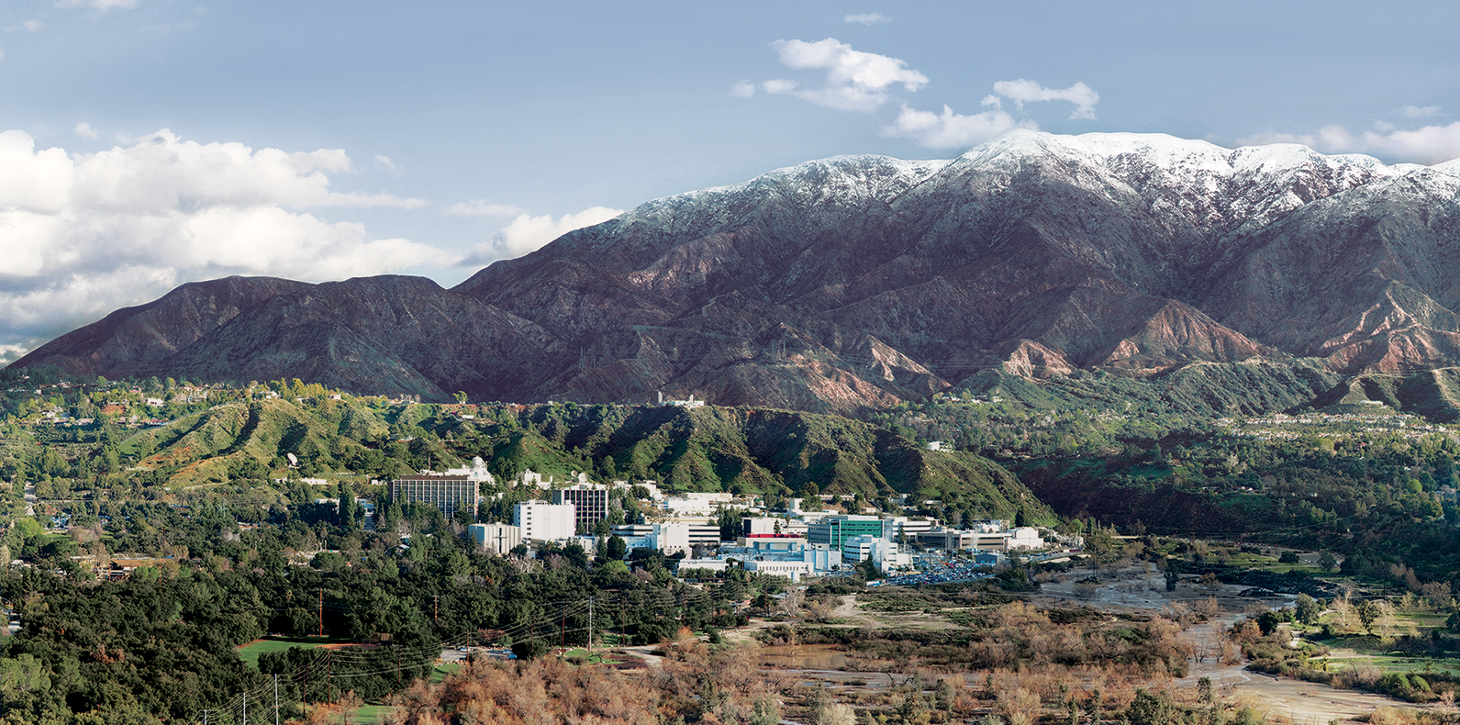
8. Spectral Calibration
Dr. David R. Thompson
Jet Propulsion Laboratory, Imaging Spectroscopy Group
July 20, 2019

Slide 2
Goals for this module
Describe common distortions caused by physical misalignments in spectrometers
Recognize, characterize and correct spectral calibration error in flight data

Slide 3
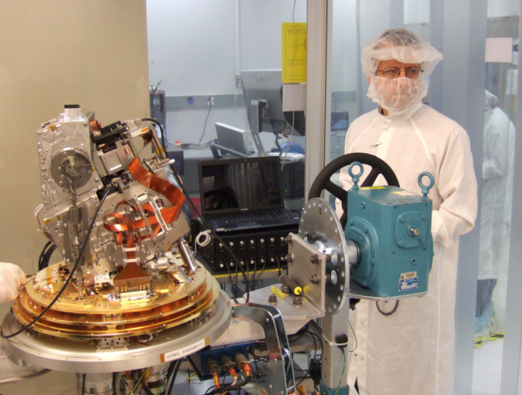
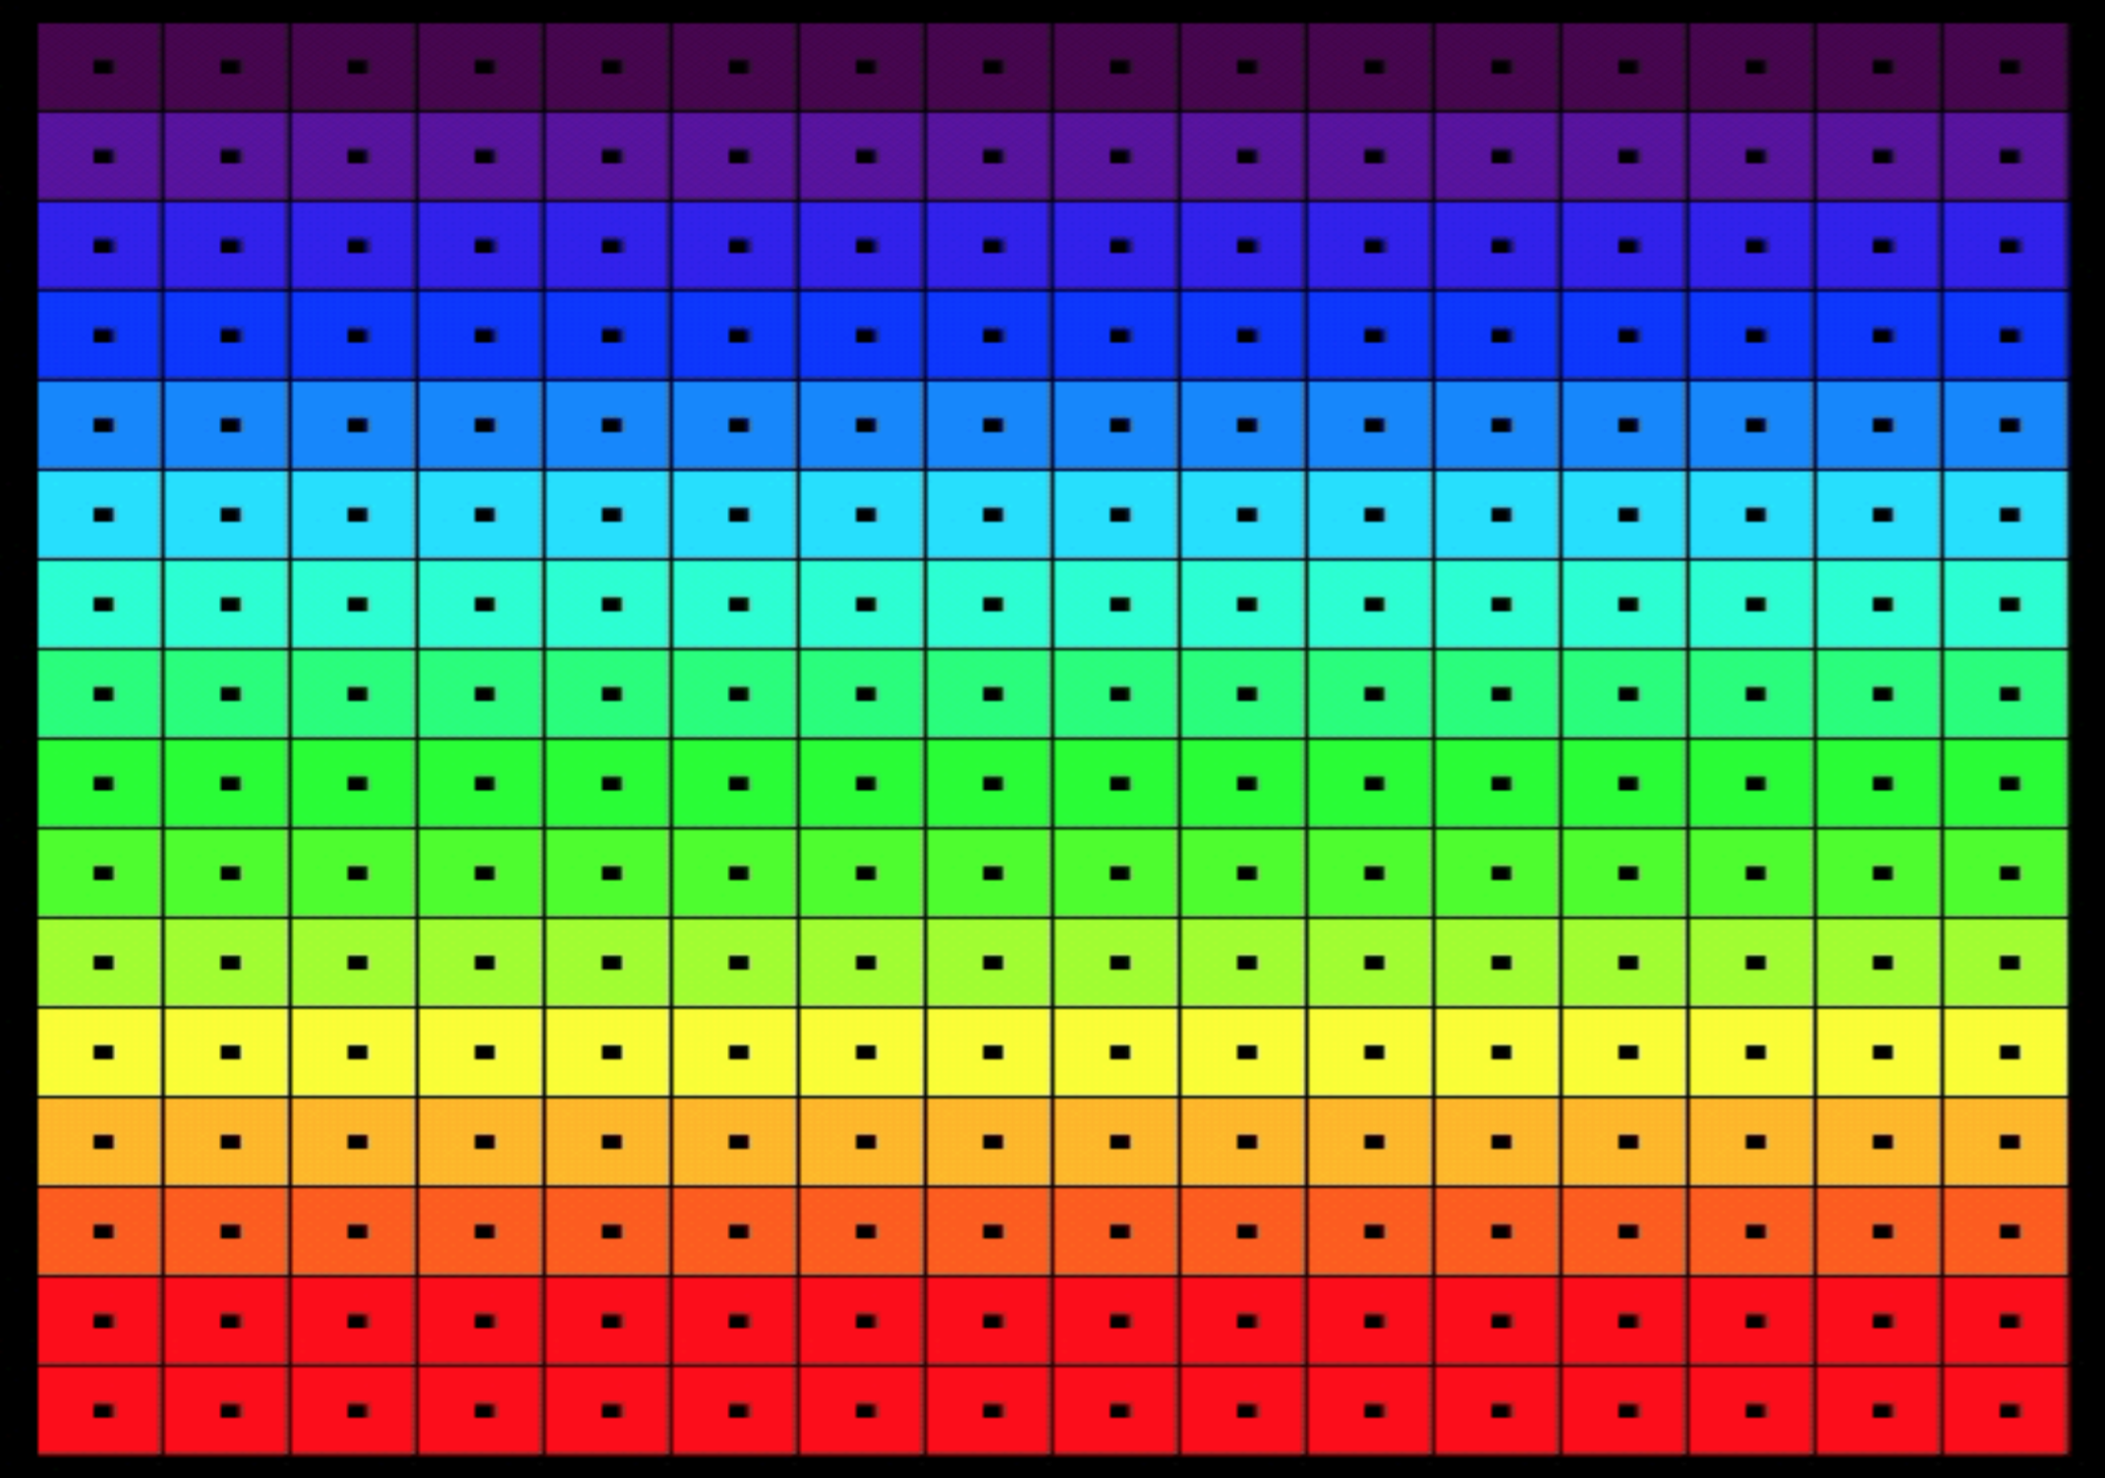
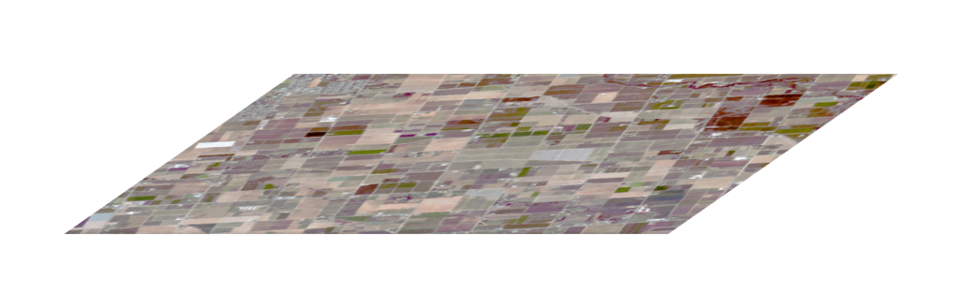
Conventions
Recall our idealized Focal Plane Array (FPA).
Spectral Calibration is the process of determining the wavelengths to which each FPA row responds.
Each detector element is sensitive to a range of wavelengths.
FPA
Spectrometer
Slit
Telescope
Rows (spectral channels)
Samples (cross-track locations)

Slide 4
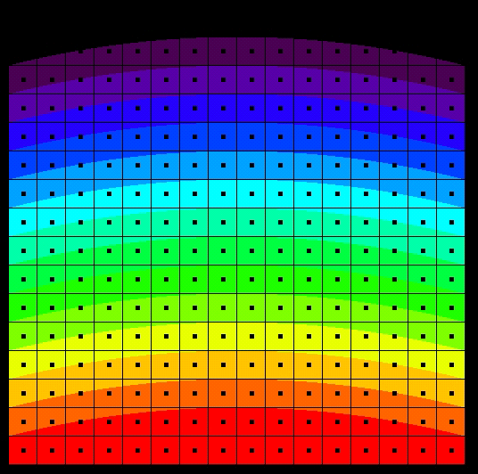
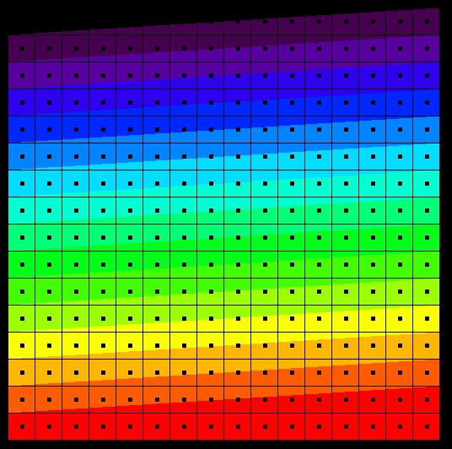
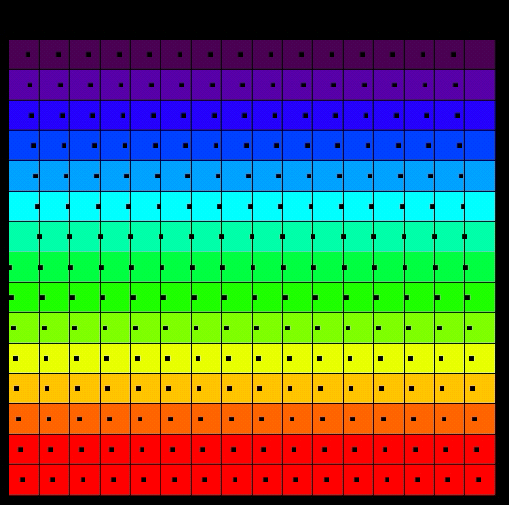
Flavors of non-uniformity
Cross Track Sample
Wavelength
Physical detectors often exhibit different kinds of alignment-related nonuniformities.
These distortions should also be characterized during the spectral calibration process.
Requirement
Failure by Frown
Wavelength
courtesy
Robert O. Green, JPL
Failure by Twist
Failure by Spectral-IFOV-Shift

Slide 5
Wavelength fitting
Often the best spectral calibration standard is the atmosphere itself. By fitting the measurement (green) to the known features of the atmosphere (red) we find the wavelength spacing and offset that best explains the data.
Courtesy Robert O. Green

Slide 6
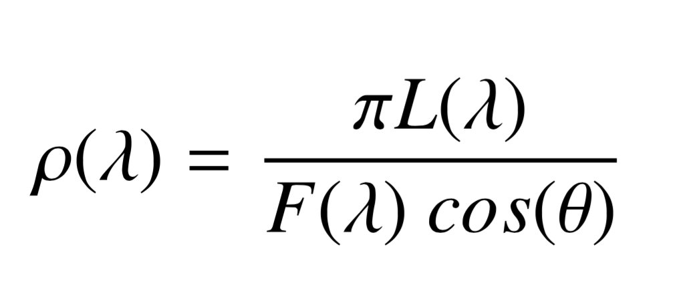
Wavelength fitting with the atmosphere
The procedure for fitting atmospheric features is straightforward.
1. Calculate an average Top of Atmosphere (TOA) reflectance for each cross-track position. This normalizes for the variable solar illumination, expressing the measurement as a fraction of incoming irradiance.
Measured radiance
Solar irradiance
Solar zenith
Typical TOA reflectance values are greater than zero, and less than one.
They preserve features’ wavelength positions.

Slide 7
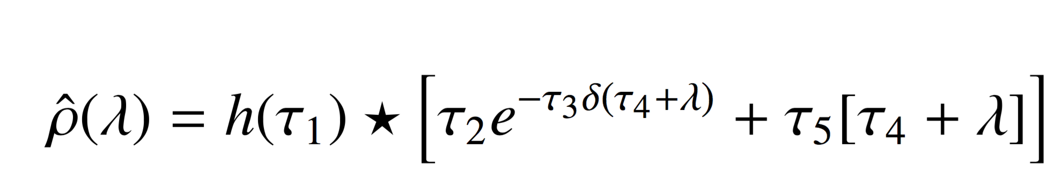
Wavelength fitting (contd.)
2. Calculate absorption coefficients for an obvious, sharp atmospheric feature using an appropriate Radiative Transfer Model (I use 6s or MODTRAN).
3. Optimize continuum and absoprtion depth via Levenberg-Maquardt gradient descent. We find the model which best fits the measured feature (note – this only works over short wavelength intervals
shift
width
A linear continuum

Slide 8
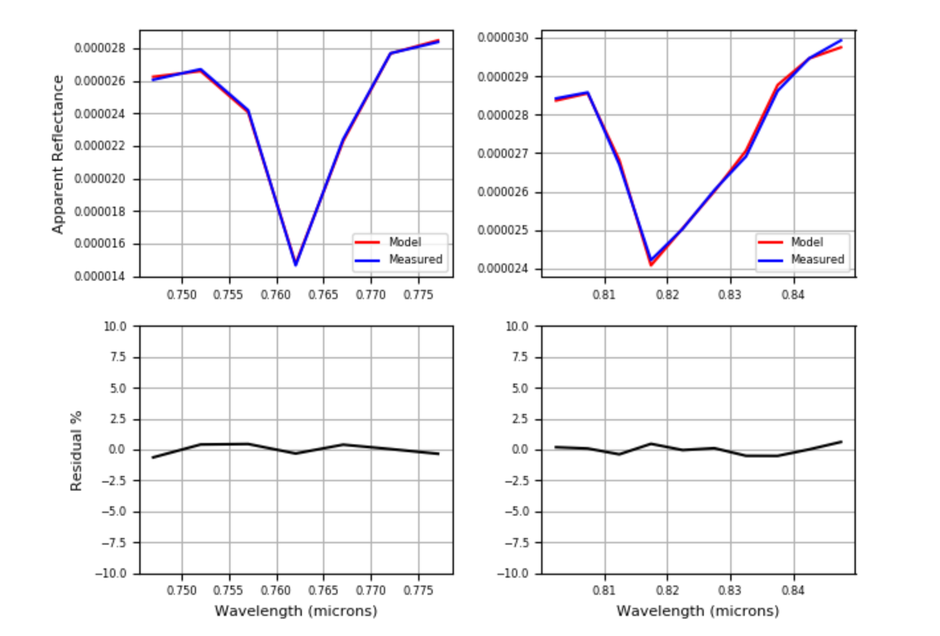
Wavelength fitting example
Apparent reflectance
Apparent reflectance
[Thompson et al., Atmos. Meas. Techniques 2015]
Residual error
Residual error
Common features used for this purpose include the oxygen A band (760 nm) and Near-Infrared H₂O vapor absorptions

Slide 9
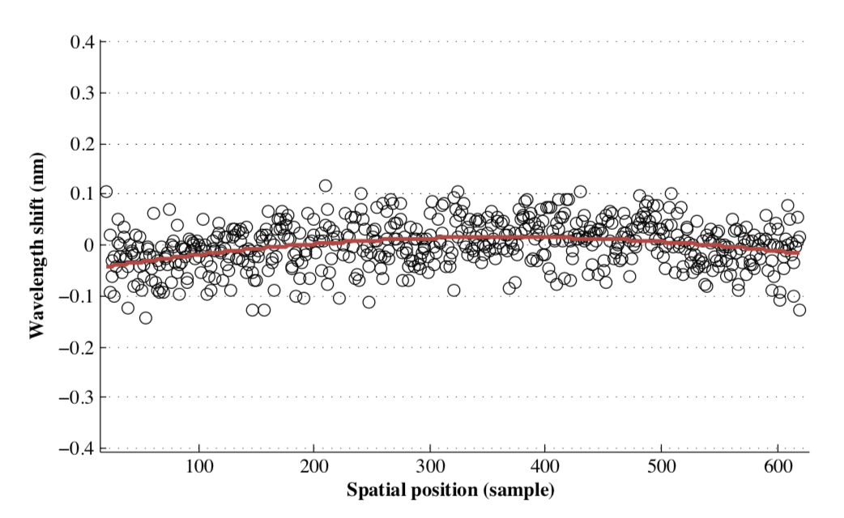
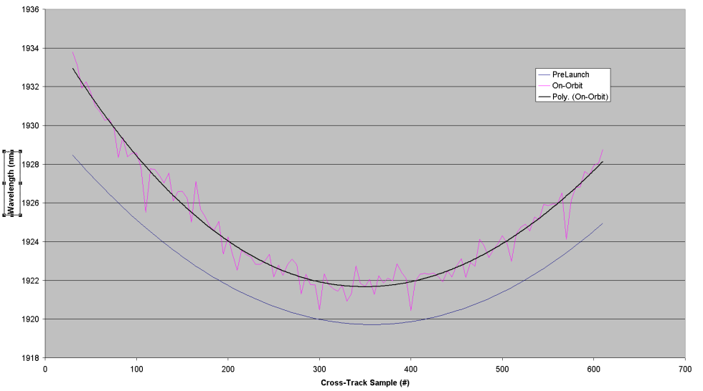
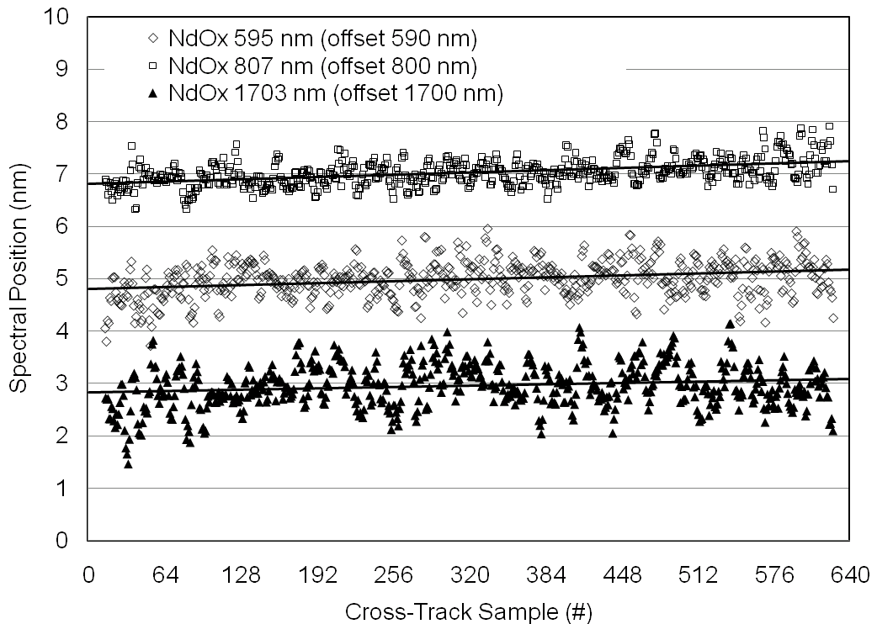
Uniformity achieved
(courtesy Robert O. Green, JPL, and others)
AVIRIS-NG
[Thompson et al., AMT 2015]
CRISM 2005
JPL M3 2008
Hyperion 2000

Slide 10
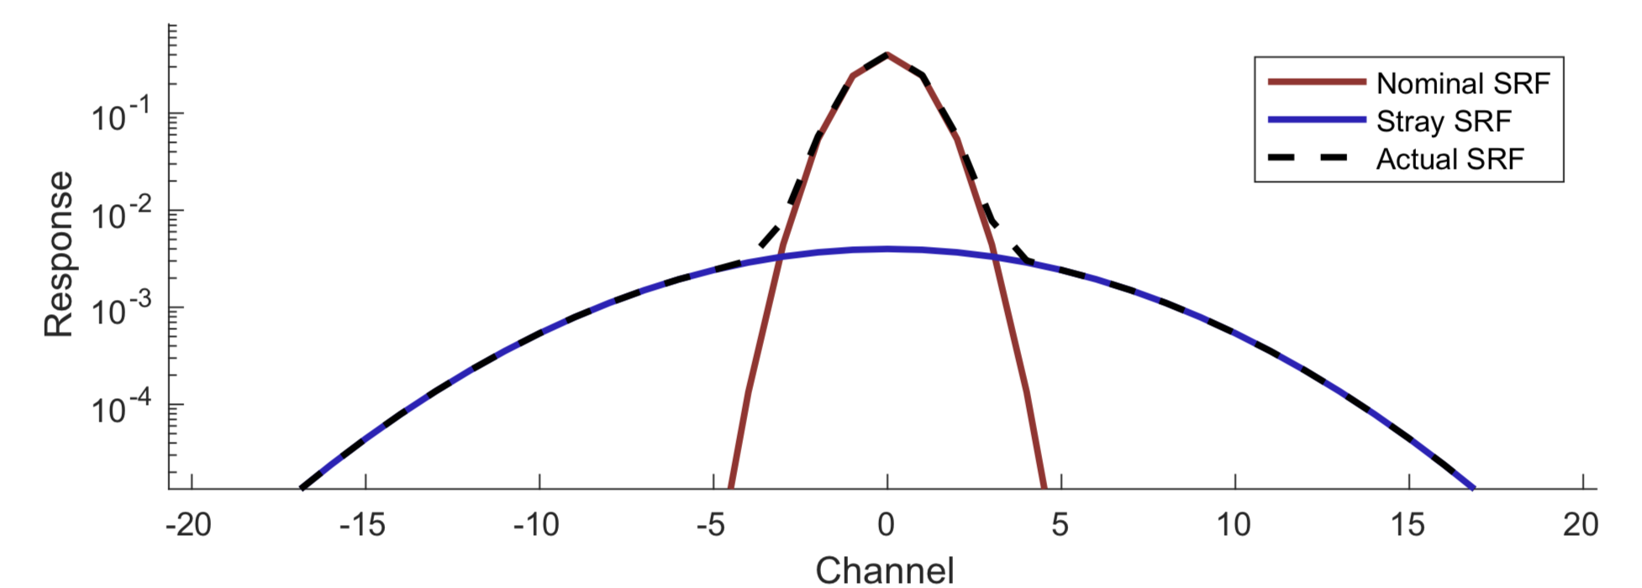
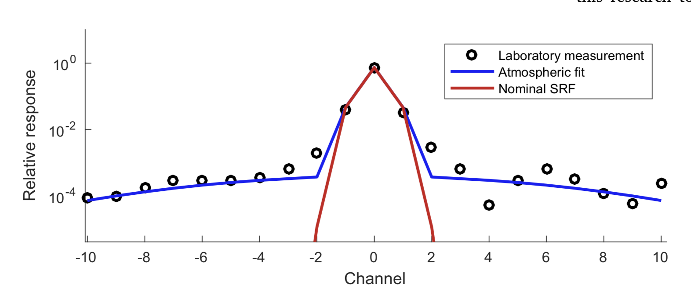
“Stray” spatial / spectral response functions
Typically each channel’s wavelength response is defined using a Gaussian distribution, with a central wavelength and a known Full Width at Half Maximum (FWHM).
However, detectors often have some “out of band response”, i.e. sensitivity to wavelengths outside the nominal Gaussian response. This stray spectral response may manifest as a thick tail, several orders of magnitude below the peak.
This seems small, but it is often enough to matter in areas of high spectral contrast.
Notional diagram – Stray Spectral Response Function (SRF)
Laboratory measurement of Stray Spectral Response Function (SRF)

Slide 11
Measurement model
To correct this distortion, we treat the stray Spectral Response Function, or SRF, and its spatial analogue, the stray Crosstrack Response Function, or CRF, as a sequence of linear blurring operators applied to the scene radiance.
Scene model
n = number of crosstrack samples
d = number of spectral channels
C = crosstrack stray light
S = spectral stray light
Solar Irradiance
Predicted Radiance
At Focal Plane Array
Measured Radiance
At Focal Plane Array
Ideal PSF
“Extra” CRF
“Extra” SRF
Atmospheric Attenuation, Scattering
(L_{pred} C)^{T} S = L_{meas}
Surface Reflectance
[d x n]
[n x n]
[d x d]
[d x n]

Slide 12
Correction approach
In order to model the distortion, we posit a functional form of the CRF and SRF with one or more free parameters (magnitude, width, etc.). I use broad Gaussians for this.
Using a Radiative Transfer Model, we simulate the measurement of a scene where radiances are somewhat predictable. Calibration scenes like playas work well.
Finally, we optimize the CRF and SRF parameters to give the best match to our data. This optimization could be a nonlinear least squares method like the Downhill Simplex or Levenberg-Marquardt approaches.

Slide 13

AVIRIS-NG example
Exploit the predictable shape of the O₂ A band
Find a haze-free day to constrain path radiance
Calculate “true” A band based on elevation and sensor altitude
Dataset: Death Valley transect, a large elevation gradient
A band
N
4000 m
Surface Elevation
-80 m
3200 m

Slide 14
Correction approach
After fitting the blurring transformation, we can then define our crosstrack and spectral blurring operators:
We correct future data using the following linear transformation:
Here, ⁺ represents the Moore-Penrose inverse, e.g.
(L_{pred} C)^{T} S = L_{meas}
[d x n]
[n x n]
[d x d]
[d x n]
L_{corr} = ((C^{T})⁺ ((S^{T})⁺ L_{meas}^{T} ) ^{T} ) ^{T}
C⁺ = (C^{T} C)⁻¹ C^{T}
C⁺C = I

Slide 15
Atmospheric fitting of PSF Tails
Pressure Altitude Retrieval Before SRF Correction
After SRF Correction
These methods can improve the radiance quality, correcting a bias in surface pressure retrievals (right). [Thompson et al., RSE 2018]
In-Flight SRF Estimate via Atmospheric Fitting
Laboratory Measurement of Subpixel Stimulus
Nominal Response Function
Spectral dimension
Spectral dimension
Spectral dimension
Spatial dimension
Spatial dimension
Spatial dimension

Slide 17
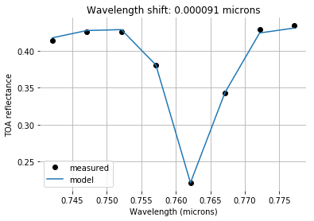
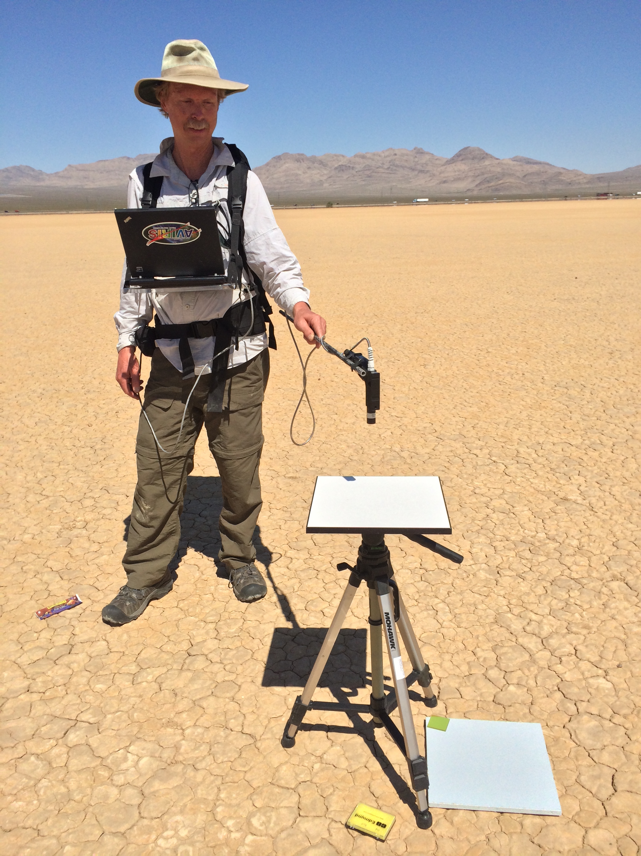
Exercise 8: Spectral Calibration
Objective: Use the atmosphere as a calibration object. Fit a modeled transmission spectrum to TOA observations.
Files include two examples of TOA reflectances acquired by the AVIRIS-NG instrument onboard a b-200 aircraft over Ivanplah playa. The exercise notebook contains fitting routines, and a transmission spectrum for appropriate observing geometry and water vapor loadings.
Pick an atmospheric feature, and eyeball an initial calibration. Start with a spectral response function that is 5-6 nm Full Width at Half Maximum. Then, fit wavelength shifts to fine tune your initial guess. Is there a way of quantifying how accurate this method can be?

